Slide 1




Automatic Character Recognition in Porcelain Ware
David Álvarez
Santiago Garrido, Luis Moreno, Adriana Birlutiu, Manuella Kadar
Notes:
1
1

Slide 2
Automatic Character Recognition in Porcelain Ware
1 – Motivation
2 – Problem Description
3 – Segmentation Process
4 – Convolutional Neural Networks
5 – Results
6 – Summary & Future Works
Automatic Character Recognition in Porcelain Ware
Notes:
2
2

Slide 3
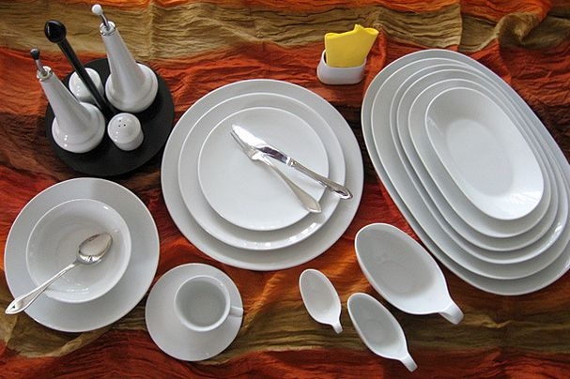
1 - Motivation
Manufacturing Process of Porcelain
Preparing the mass
Powder atomization
Shaping the object
Burning 1
Glazing
Burning 2
Quality control
Sorting
Automatic Character Recognition in Porcelain Ware
Notes:
3
3

Slide 4
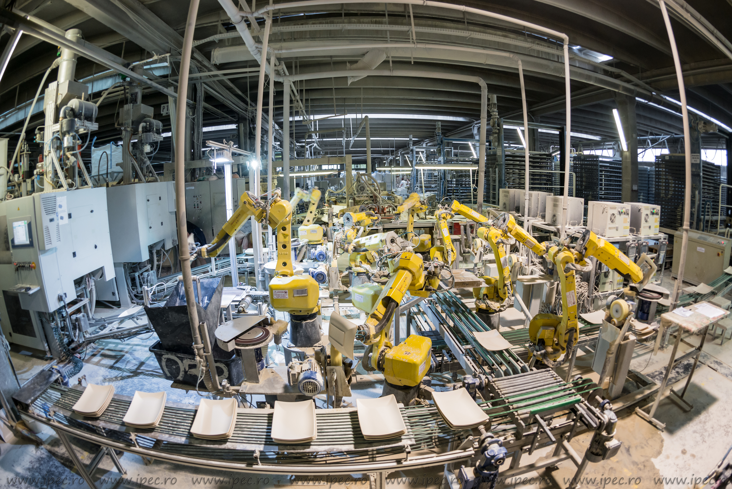
1 - Motivation
Automatic Character Recognition in Porcelain Ware
Notes:
4
4

Slide 5
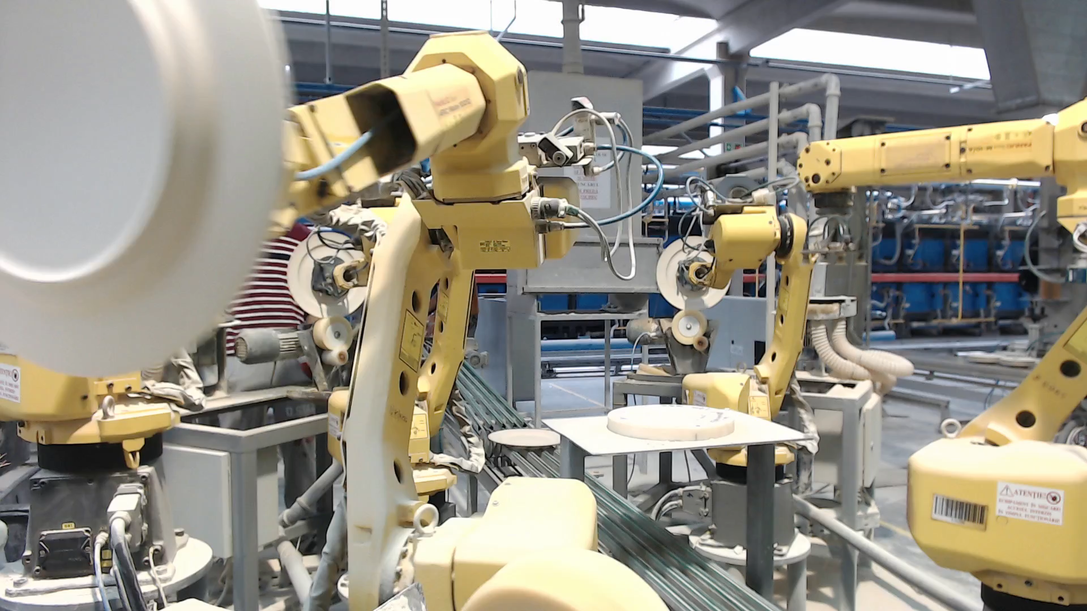
1 - Motivation
Automatic Character Recognition in Porcelain Ware
Notes:
5
5

Slide 6
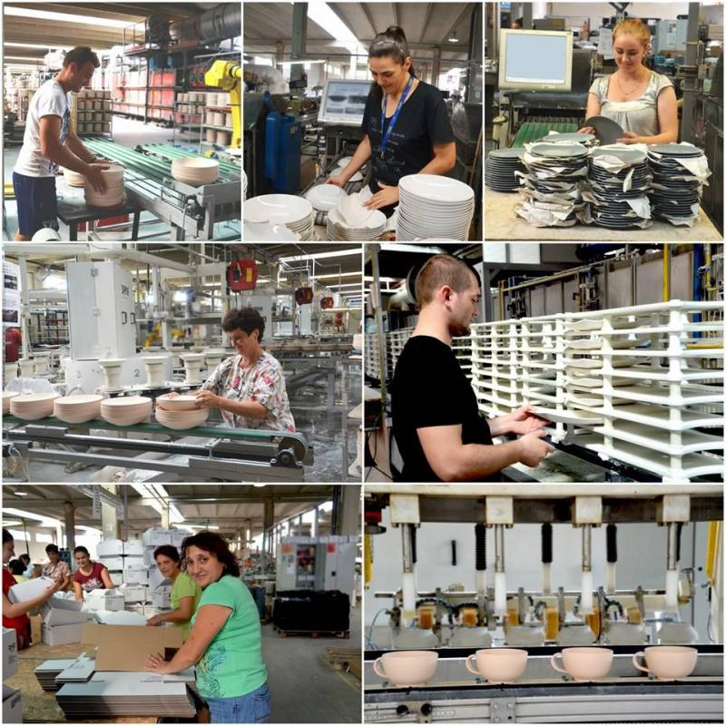
1 - Motivation
Quality control after:
1) Burning 1
2) Glazing
3) Sorting
Estimated cost reduction
- 60% in HR
- 20% in materials
Automatic Character Recognition in Porcelain Ware
Notes:
6
6

Slide 7
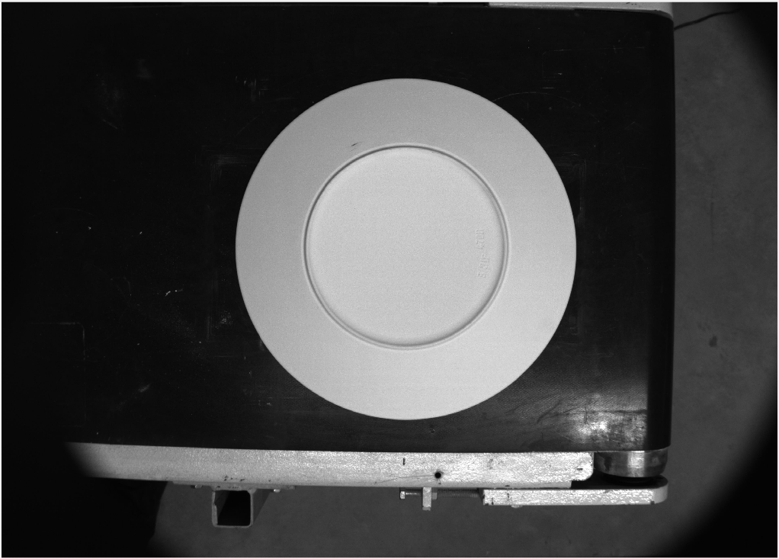
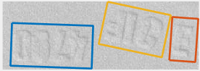
2 – Problem Description
3 groups of characters:
- Sack of material
- Work shift
- Product type
SEGMENTATION
+
IDENTIFICATION
Solution
Automatic Character Recognition in Porcelain Ware
Notes:
7
7

Slide 8
3 – Segmentation Process
Objective: segment individual characters.
Solution: recursively look for geometric properties and segment.
Automatic Character Recognition in Porcelain Ware
Notes:
8
8

Slide 9
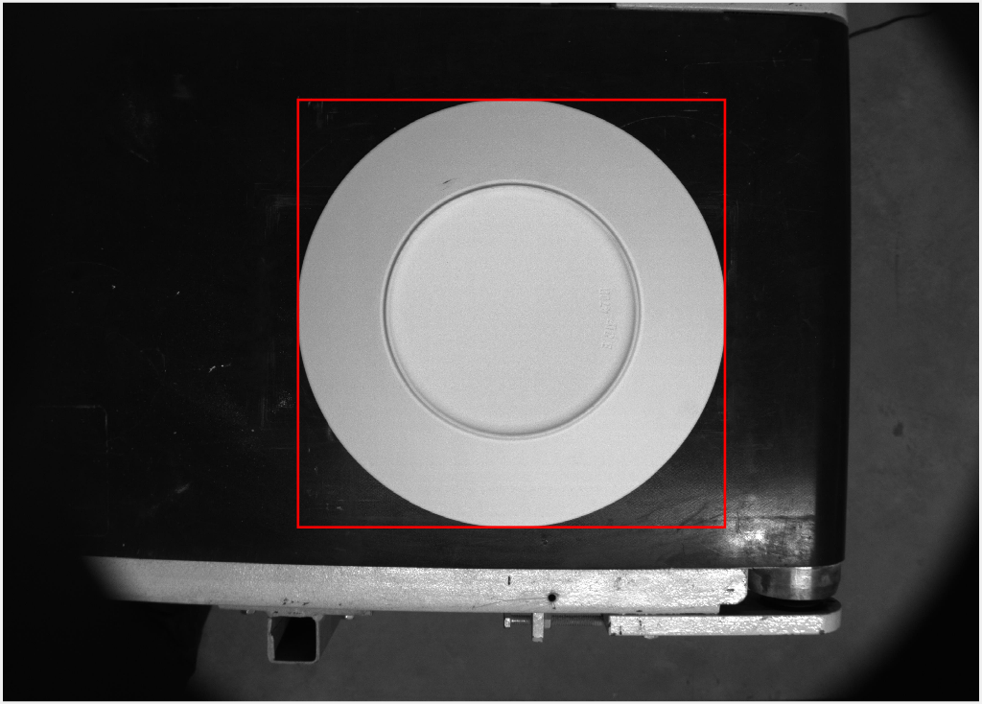
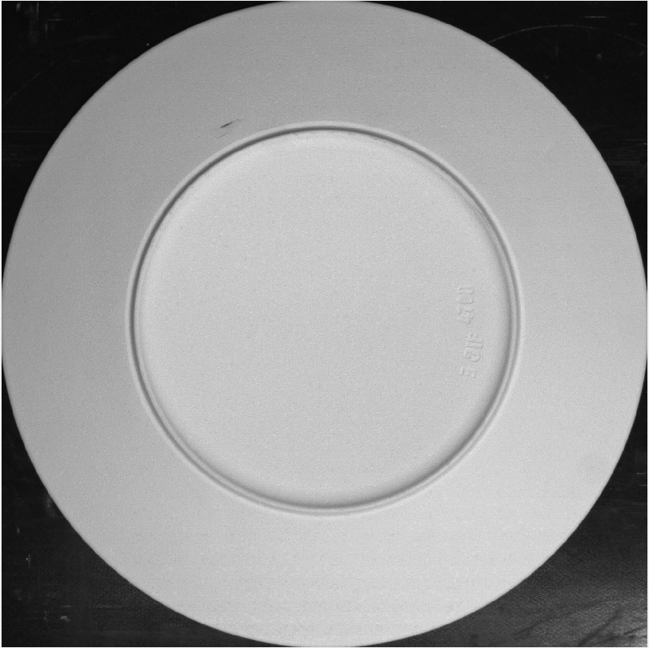
3 – Segmentation Process
Solution: binarize image, study 8-connected components in contiguous regions.
Outer Bounding Box of largest object
Automatic Character Recognition in Porcelain Ware
Notes:
9
9

Slide 10
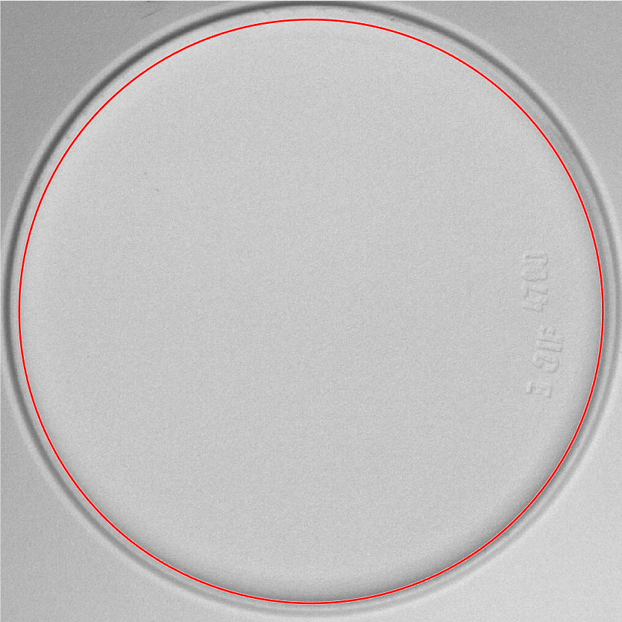
3 – Segmentation Process
Solution: study geometric properties and segment.
Segment inner circle
Automatic Character Recognition in Porcelain Ware
Notes:
10
10

Slide 11
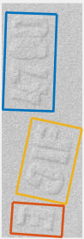
3 – Segmentation Process
Solution: binarized image, study 8-connected components in contiguous regions.
Perform several binarizations until 3 boxes of the expected area are found.
Automatic Character Recognition in Porcelain Ware
Notes:
11
11

Slide 12
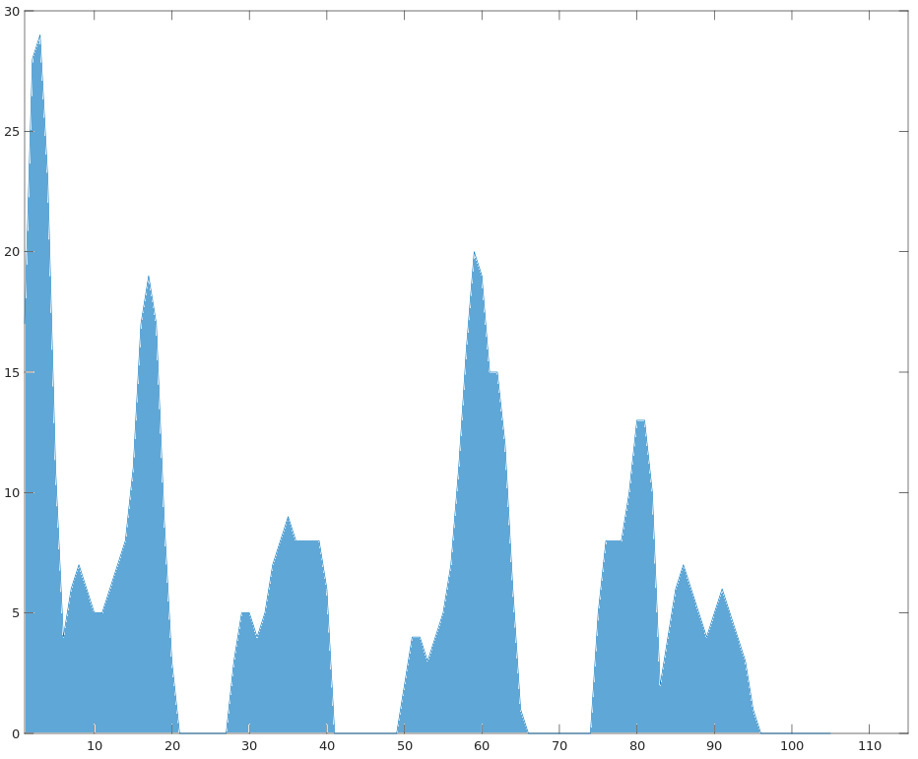
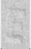
3 – Segmentation Process
Solution: binarize image and study X-projection
Fix size: 59*35º
Automatic Character Recognition in Porcelain Ware
Notes:
12
12

Slide 13
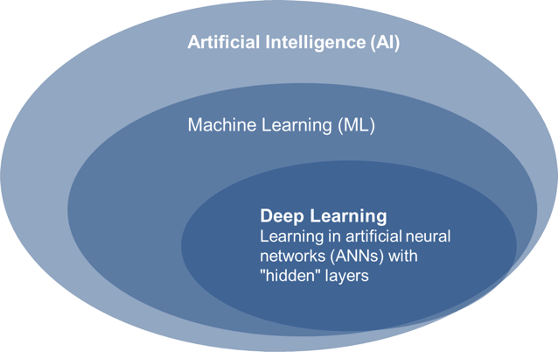
4 – Convolutional Neural Network
Automatic Character Recognition in Porcelain Ware
Notes:
13
13

Slide 14
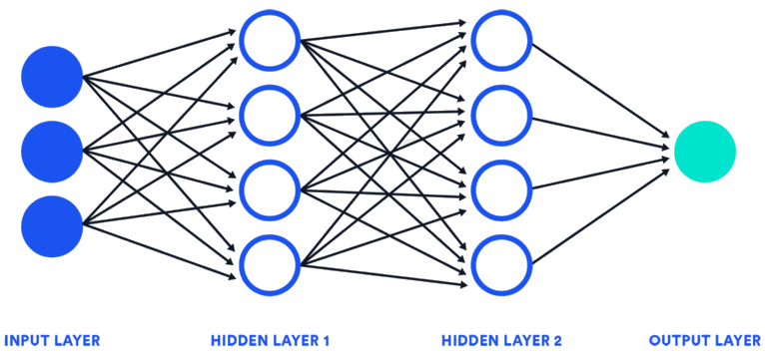
4 – Convolutional Neural Network
Automatic Character Recognition in Porcelain Ware
Notes:
14
14

Slide 15
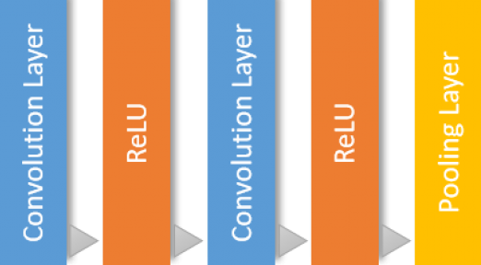
4 – Convolutional Neural Network
Hidden Layer 1
Feature extraction & Learning
Automatic Character Recognition in Porcelain Ware
Notes:
15
15

Slide 16
4 – Convolutional Neural Network
Hidden Layer 1
- Convolutional Filters:
Filter Size
Number of Filters
Feature extraction & Learning
Automatic Character Recognition in Porcelain Ware
Notes:
16
16

Slide 17
4 – Convolutional Neural Network
Hidden Layer 1
- Rectified Linear Unit:
Maps positive features
Negative ones → Zero
Feature extraction & Learning
Automatic Character Recognition in Porcelain Ware
Notes:
17
17

Slide 18
4 – Convolutional Neural Network
Hidden Layer 1
- Pooling:
Simplifies output
Nonlinear downsampling
Feature extraction & Learning
Automatic Character Recognition in Porcelain Ware
Notes:
18
18

Slide 19

4 – Convolutional Neural Network
Hidden Layer 2
Softmax
Classification
Fully Connected
Classification
Automatic Character Recognition in Porcelain Ware
Notes:
19
19

Slide 20
4 – Convolutional Neural Network
Hidden Layer 2
- Fully connected:
Maps positive features
Output Size = # Clases
Softmax
Classification
Fully Connected
Classification
Automatic Character Recognition in Porcelain Ware
Notes:
20
20

Slide 21
4 – Convolutional Neural Network
Hidden Layer 2
- Softmax:
Normalize inputs
Output Size = Probabilities
Softmax
Softmax
Classification
Classification
Fully Connected
Classification
Automatic Character Recognition in Porcelain Ware
Notes:
21
21

Slide 22
4 – Convolutional Neural Network
Hidden Layer 2
- Classification:
Decision on the class
based on Probabilities
Softmax
Classification
Classification
Fully Connected
Classification
Automatic Character Recognition in Porcelain Ware
Notes:
22
22

Slide 23
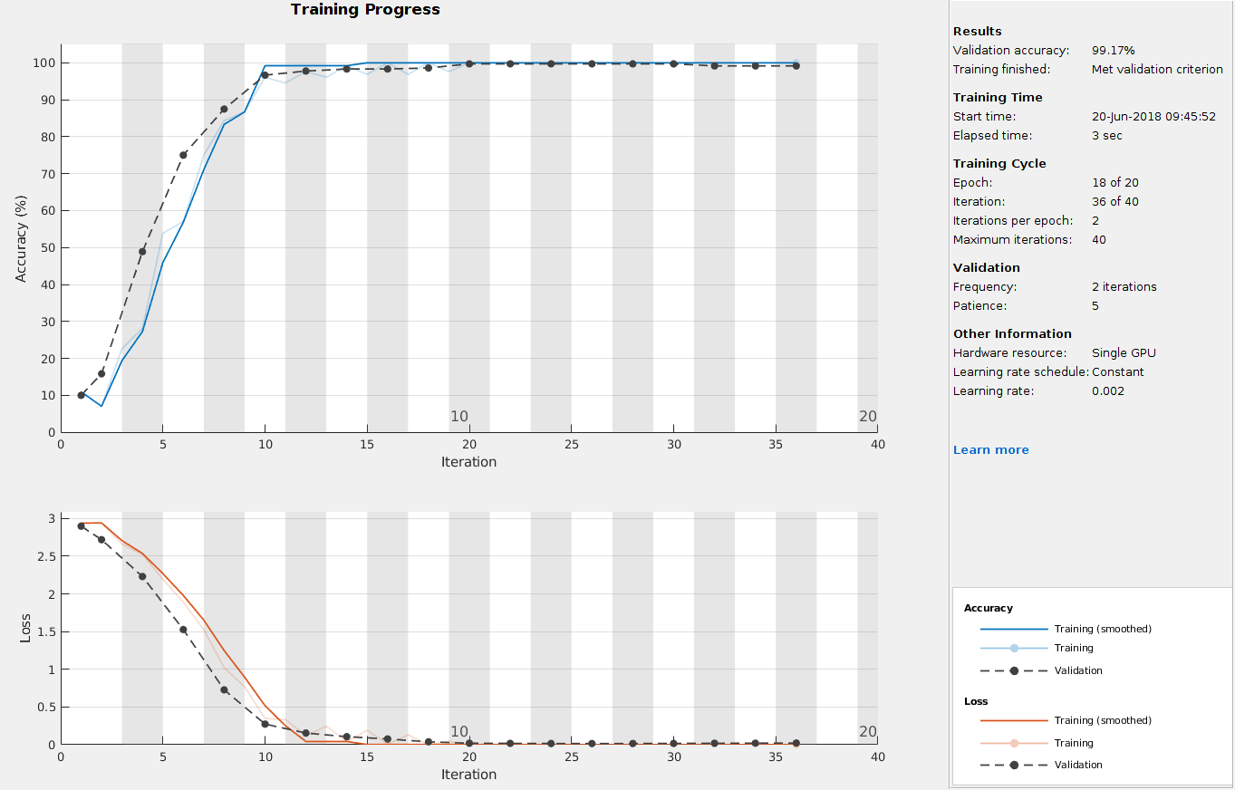
5 – Results
Automatic Character Recognition in Porcelain Ware
Notes:
23
23

Slide 24
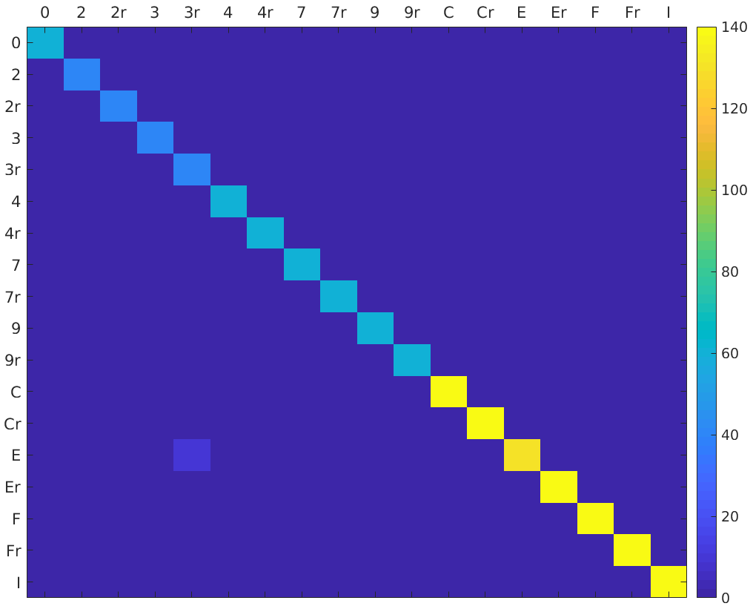
5 – Results
Automatic Character Recognition in Porcelain Ware
Notes:
24
24

Slide 25
6 – Summary & Future Work
Successful Character Recognition in round flat plates.
Parameterize segmentation process for other types of ware.
Add more characters to the database.
Study possible corrections for bad detections.
Automatic Character Recognition in Porcelain Ware
Notes:
25
25

Slide 26
Automatic Character Recognition in Porcelain Ware
David Álvarez Sánchez
Notes:
26
26

